Slide 1
Developing with .NET on Microsoft Azure

Slide 2
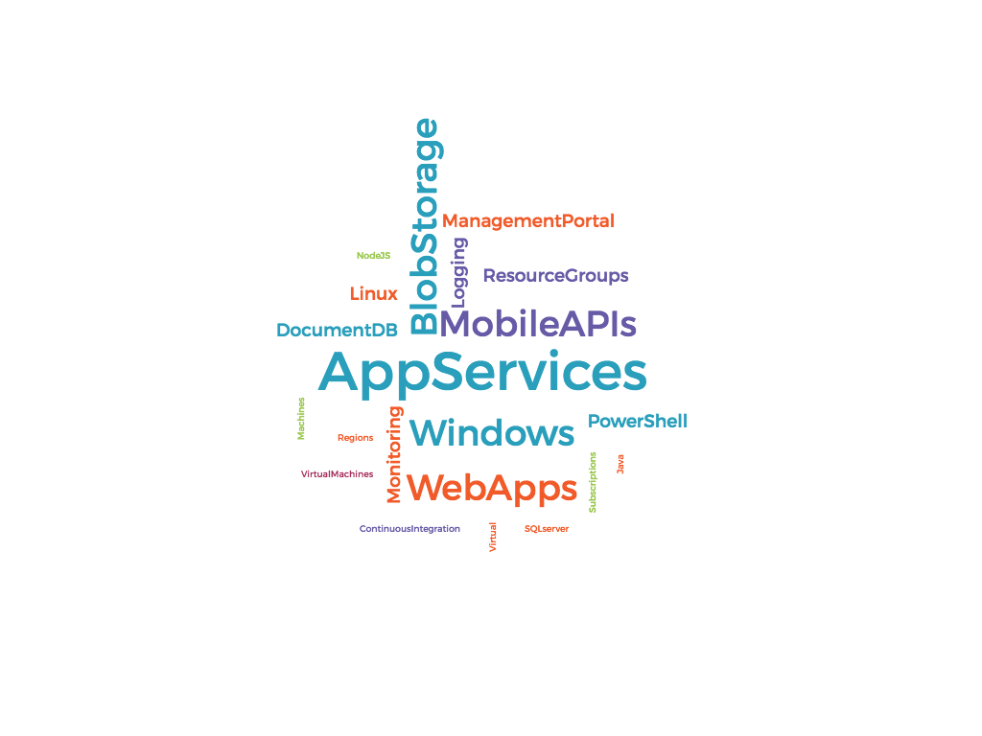
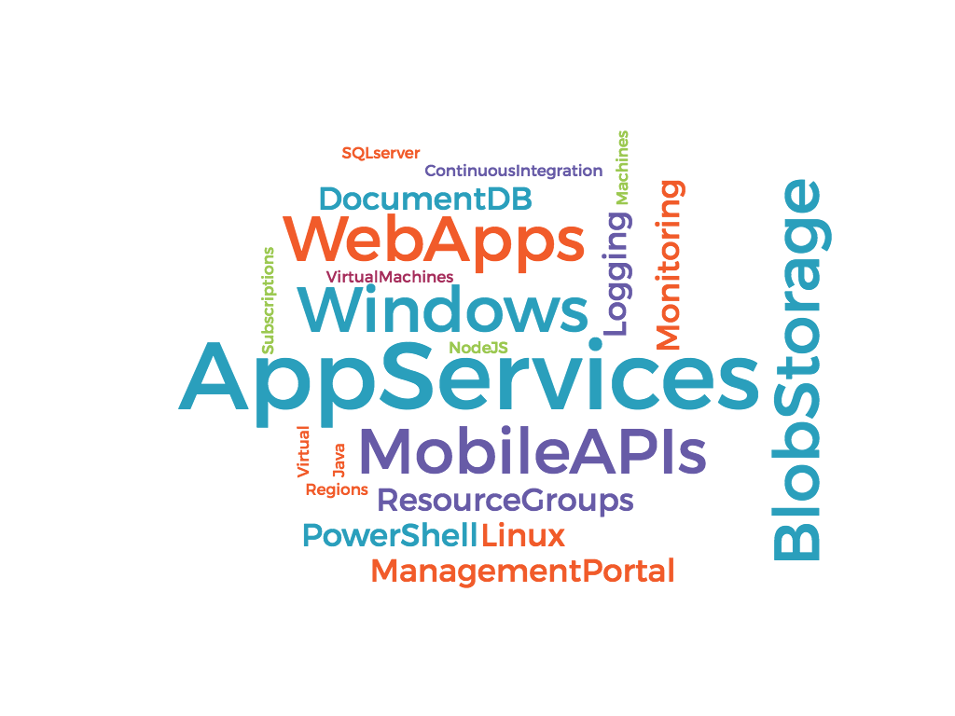
Notes:
Here I was thinking of having a large tag cloud with Azure related terms. Use this to introduce the basic idea of “what is azure” and how we will dispel lthe mumbo jumbo

Slide 3




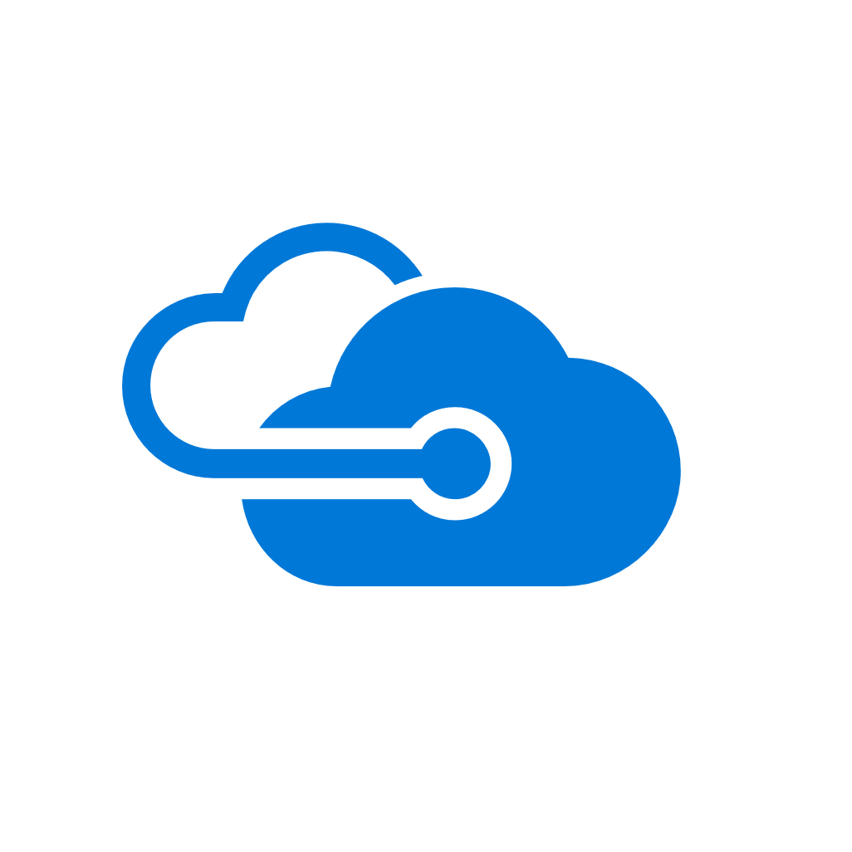
Microsoft
Azure
Notes:
The idea is to show the breadth of support Azure provides for different technologies.

Slide 4
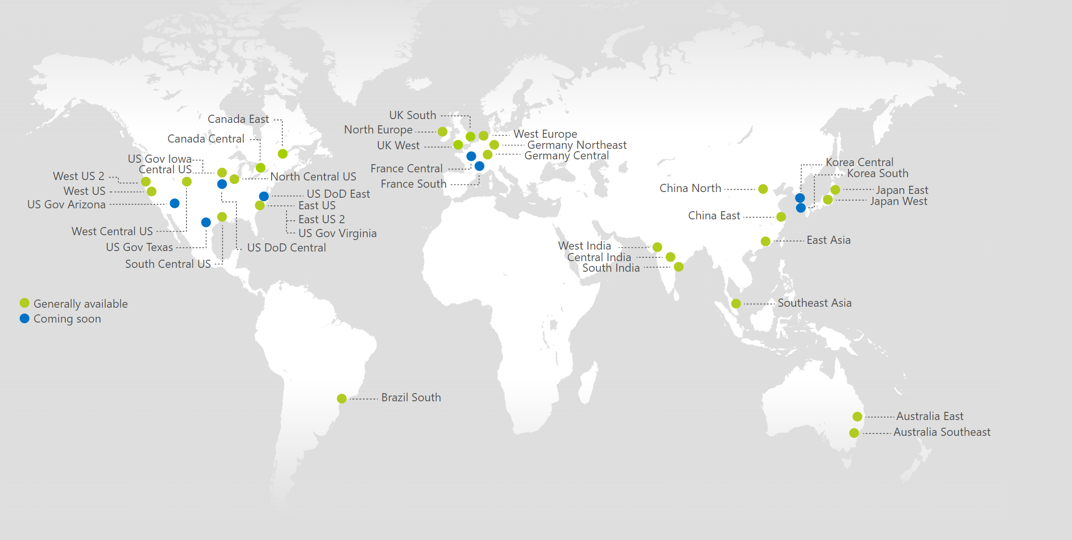
Azure Data Centers
https://azure.microsoft.com/en-us/regions/
Notes:
This map from the MSFT documentation shows the Azure data centers all across the world. The idea is to marvel in awe at the data centers around the world.

Slide 5








Virtual Machines
Cloud Databases & Storage
Microsoft
Azure
App Services &
Functions
Automation
Notes:
These are the azure resources we’ll be using in the course. In Azure itself there are 2 dozen more things we could use, but I think I just want to highlight the stuff we’ll see in the course. These should animate in clockwise

Slide 6
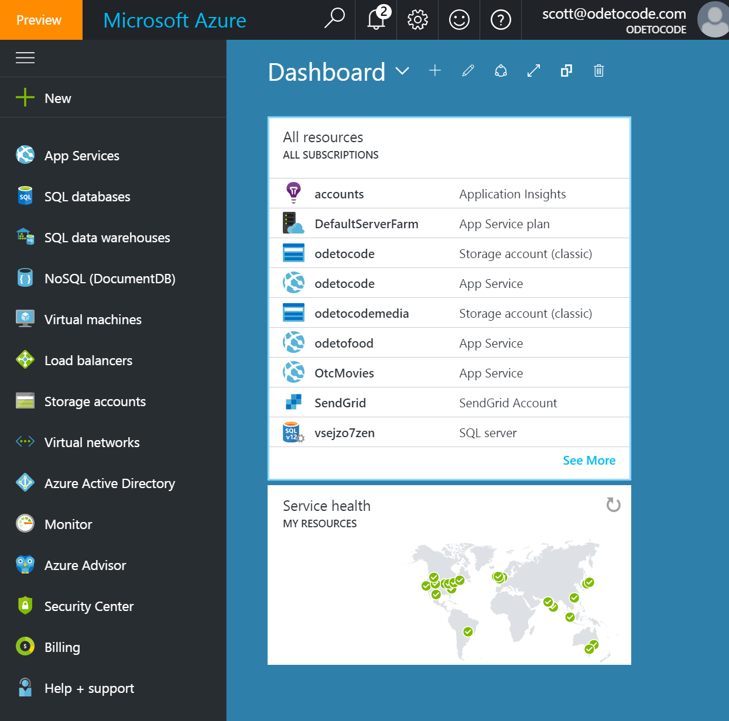
Web Portal
Notes:
There will be a couple different ways to create and manage a resource in azure, the web portal, or powershell. We’ll start with the portal.

Slide 7
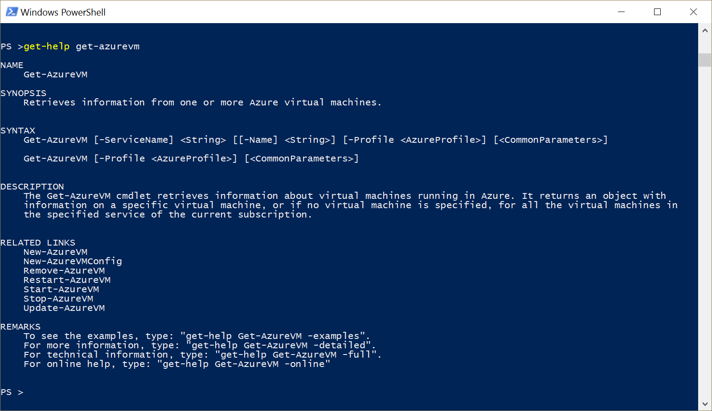
PowerShell
Notes:
There will be a couple different ways to create and manage a resource in azure, the web portal, or powershell. We’ll start with the portal.

Slide 8
Web Portal
Notes:
There will be a couple different ways to create and manage a resource in azure, the web portal, or powershell. We’ll start with the portal.

Slide 9
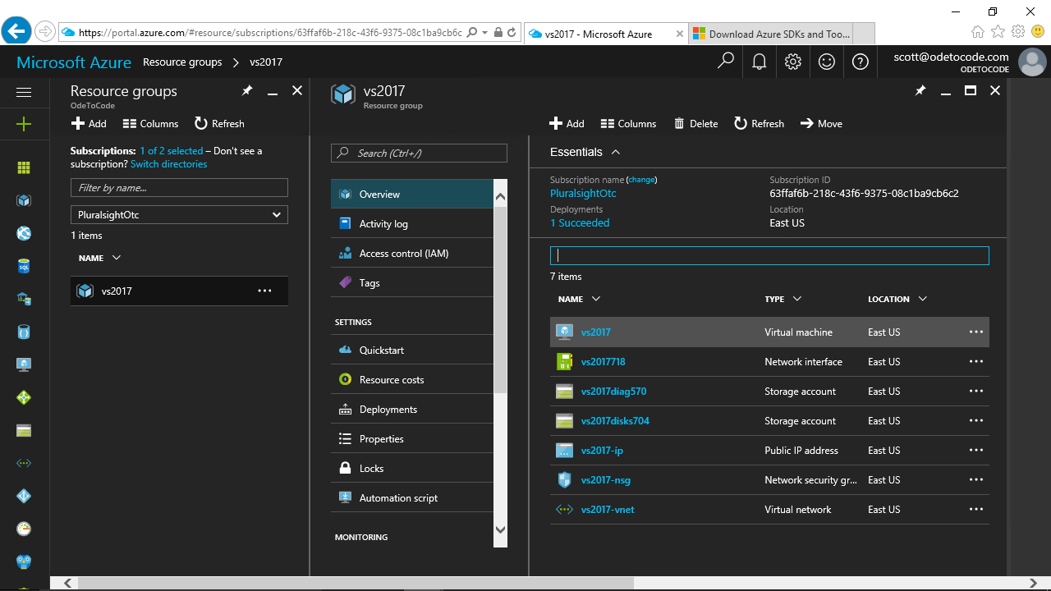
Will paste in a new pic of our portal as it ended in the recording
Summary

